Slide 1
Python Computing Library
순천향대학교
박성근(keiny@sch.ac.kr)

Slide 2


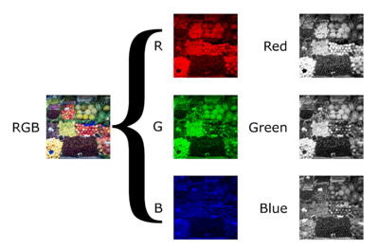
Machine Learning == Flow of Tensor
Channel
Matrix
(width×height)
Tensor
(width×height×depth†¹)
e.g. grayscale image
(1-channel)
e.g. rgb image
(3-channels)

Slide 3
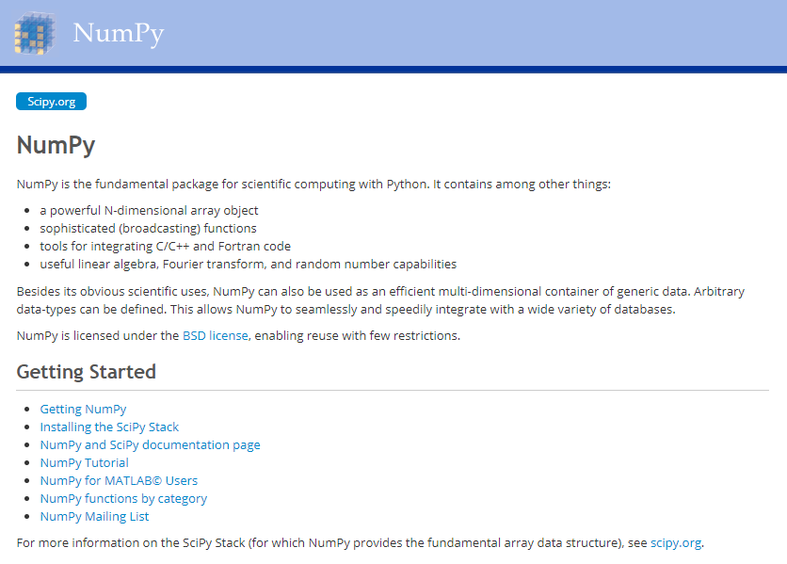
Numpy
Anaconda

Slide 4
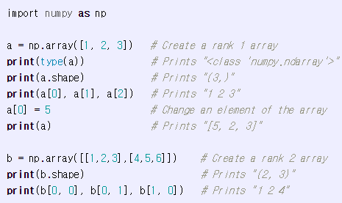
Arrays in Numpy
Python List to Numpy Array

Slide 5
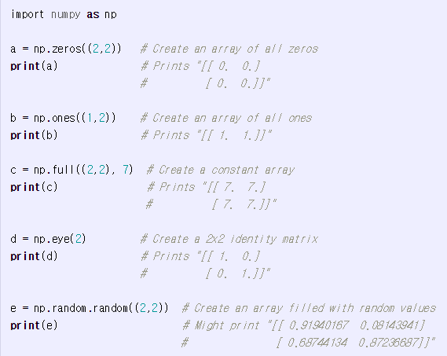
Array Function in Numpy

Slide 6
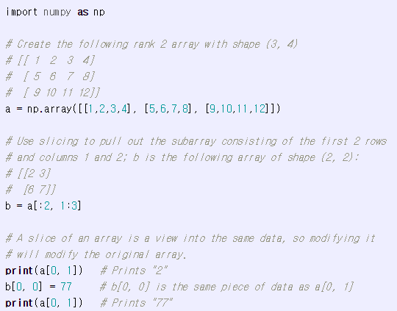
Array Indexing in Numpy
Slicing

Slide 7
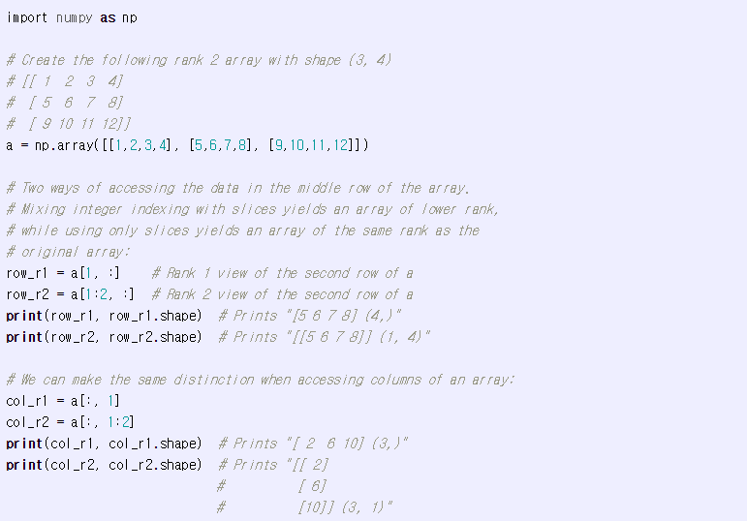
Array Indexing in Numpy

Slide 8
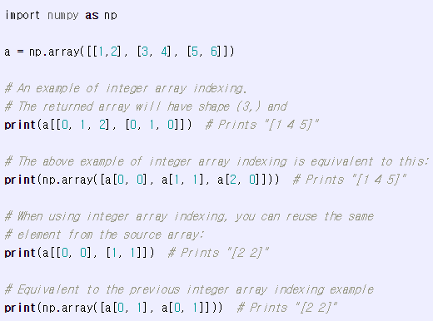
Array Indexing in Numpy

Slide 9
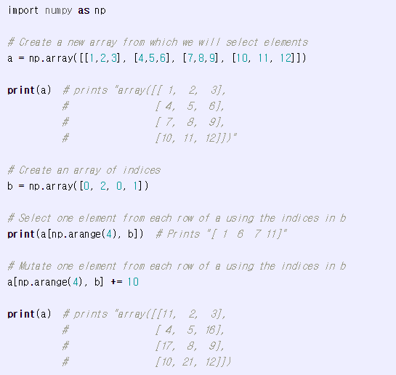
Array Indexing in Numpy

Slide 10
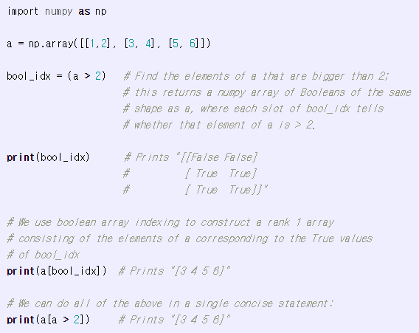
Array Indexing in Numpy

Slide 11
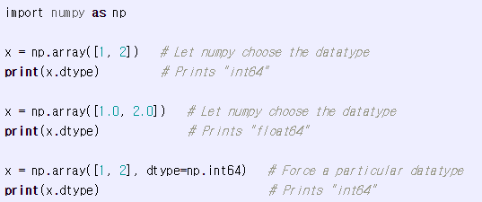
Datatype in Numpy

Slide 12
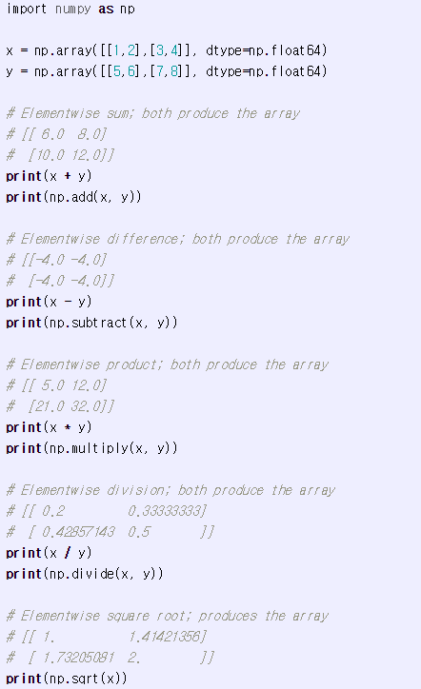
Array Math in Numpy

Slide 13
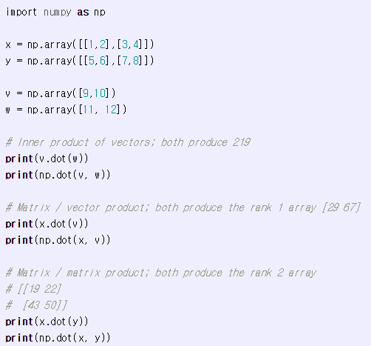
Array Math in Numpy

Slide 14
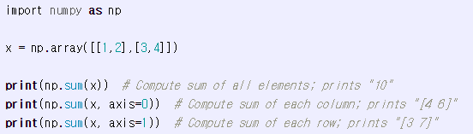
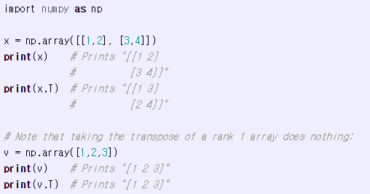
Array Math in Numpy
※ np.transpose(v) ?

Slide 15
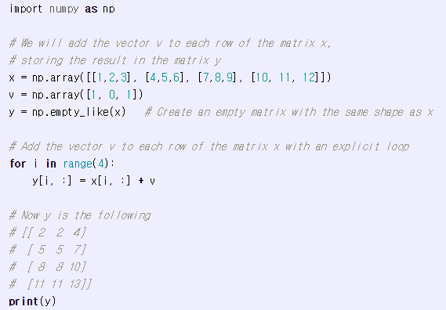
Broadcasting in Numpy

Slide 16
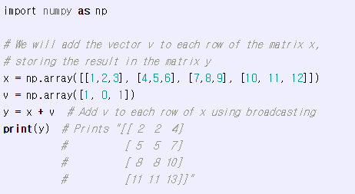
Broadcasting in Numpy

Slide 17
Broadcasting in Numpy
Broadcasting two arrays together follows these rules:
If the arrays do not have the same rank, prepend the shape of the lower rank array with 1s until both shapes have the same length.
The two arrays are said to be compatible in a dimension if they have the same size in the dimension, or if one of the arrays has size 1 in that dimension.
The arrays can be broadcast together if they are compatible in all dimensions.
After broadcasting, each array behaves as if it had shape equal to the elementwise maximum of shapes of the two input arrays.
In any dimension where one array had size 1 and the other array had size greater than 1, the first array behaves as if it were copied along that dimension
https://docs.scipy.org/doc/numpy/user/basics.broadcasting.html

Slide 18
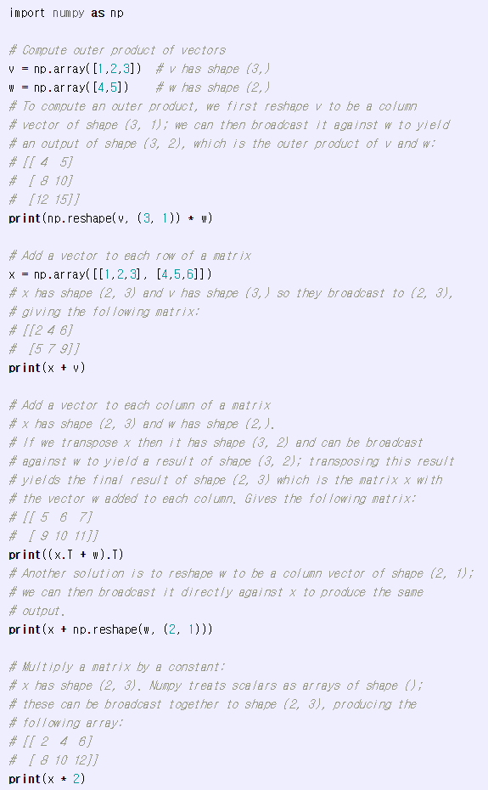
Broadcasting in Numpy

Slide 19
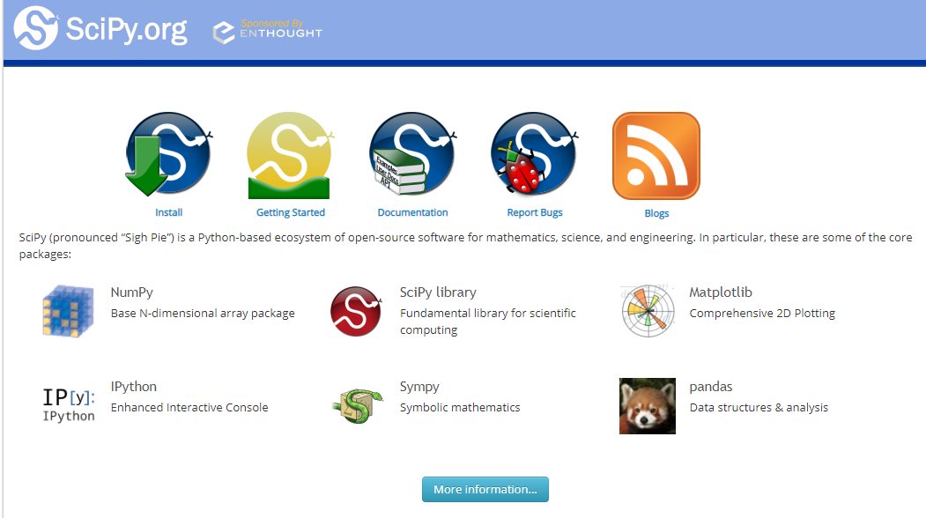
Scipy - SCIentific computing and technical computing Python library

Slide 20
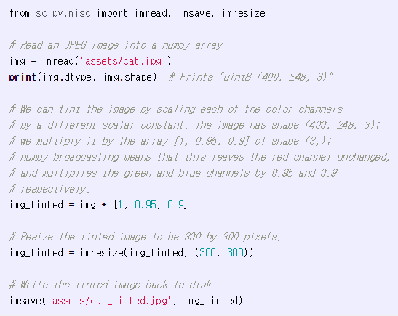
Image Read & Write

Slide 21
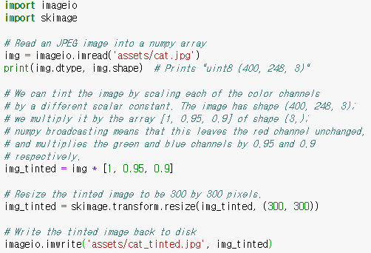
Image Read&Write

Slide 22
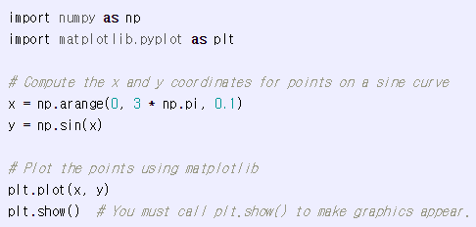
Matplotlib - Plot

Slide 23
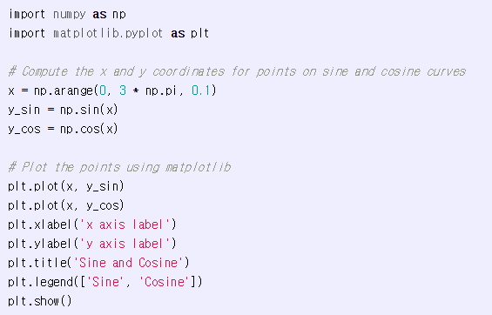
Matplotlib – Multi-plot

Slide 24
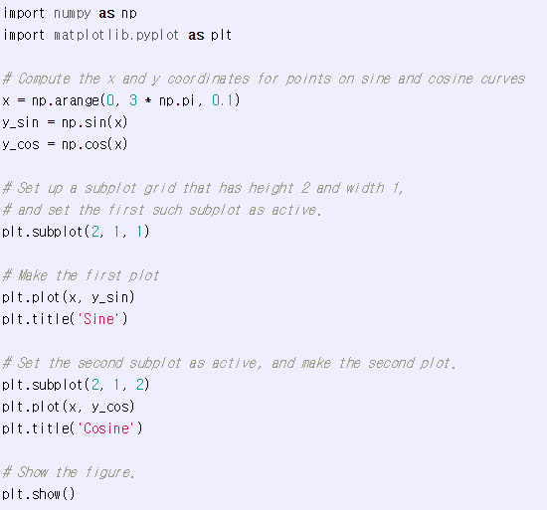
Matplotlib - subplot

Slide 25
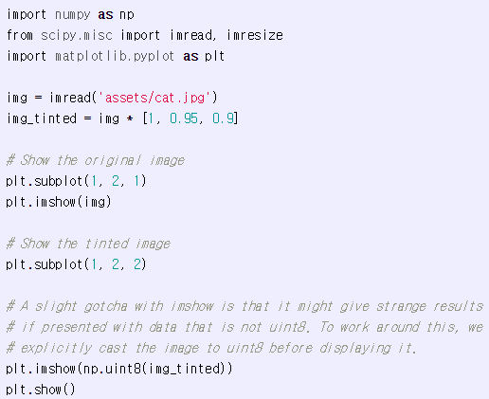
Matplotlib - subplot

